Slide 1

Intro to HTML and CSS
Natassja Linzau
9/15/2016

Slide 2

Natassja Linzau (nlinzau@doc.gov)
Lead of Data Education Initiatives
Front End Engineer
Commerce Data Service
US Department of Commerce
Data Academy questions:
DataAcademy@doc.gov

Slide 3
Goals
Walk away with the foundations for :
Understanding how tags and other HTML elements structure the content of a webpage
Being able to create a basic webpage using HTML and CSS
Understanding how CSS interacts with HTML
Developing a lifelong appetite for coding!

Slide 4
Commerce Data Academy
A data education initiative of the Commerce Data Service (CDS).
Launched by the CDS to offer data science, data engineering, and web development training to employees of the U.S. Department of Commerce.
Course schedule and materials (e.g. slides, code, papers) produced for the Commerce Data Academy can be found on our website at http://dataacademy.commerce.gov.
Questions? Feel free to write us at Data Academy (dataacademy@doc.gov).

Slide 5
Course Files
If you don’t have a copy of the PowerPoint presentation or files, go to my GitHub and download them:
https://github.com/dcwebmaven/HTML-CSSCourse

Slide 6
Background Questions
What is programming?
What is the difference between websites, web applications, and native applications (mobile or tablet)?
What is Front End Engineering vs. Back End Engineering?
Notes:
Programming is: 1. A step by step process, 2. A recipe for making something, 3. A set of instructions (Idea: We’re telling computers what to do)
There are lots of things that developers can do. This course will focus on websites, which are basically a document or set of webpages that are used to display content to the public on the web. That means telling the computer how to display and format a document.
Next step: Web development, where you build web applications—more interactive, lots of data manipulated and shared (administrative sites, Twitter, Facebook, etc.)
Go further: Native applications—like building specifically for iPhone (IOS) or Android or other devices using their platform
Front End Engineering=content of the page, images, visual styling, code describing interactive parts of website
Back End Engineering=actual software that runs on a server; includes website content, storage of data, and any business logic needed to validate or manipulate the data (Examples: Ruby, Python, Perl, PHP, etc.)

Slide 7
Front End
HyperText Markup Language (HTML)
Cascading Style Sheets (CSS)
JavaScript
Notes:
Today we will be doing a deep dive into HTML and CSS. JavaScript is a more advanced programming language and will be covered in our next course, on 9/29. Be sure to sign up for that if you haven’t already!

Slide 8
HyperText=text you can click on--hyperlinks Markup=highlighting parts of content for description Language=communication (you + computer)

Slide 9
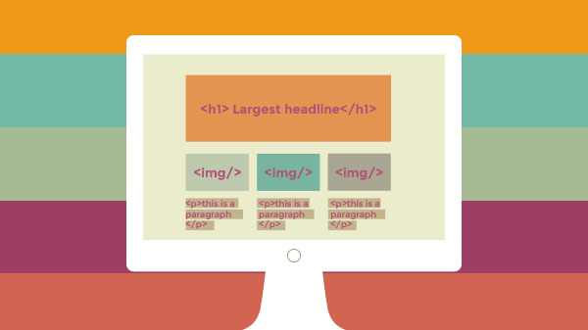
HyperText Markup Language (HTML)
HTML describes the structure of a webpage to your browser.

Slide 10
HTML Tags
<h1>This is a headline</h1>
<p>This is a paragraph.</p>
<p>This is a second paragraph.</p>
<p>This is a third paragraph.</p>
Each individual element has its own tag.
You can write HTML just like normal text and save it in a file with .html at the end.
HTML is the only thing you have to have for a website.
Notes:
Your computer can tell the difference between a headline and a bunch of paragraphs because each individual element has its own tag.

Slide 11
HTML supports many types of media:
<p> | <audio> | <video> | <li>
<img> | <article> | <button> | <em>

Notes:
In order to put any one type of media in your website, you have to use its specific HTML tag. For example, videos get <video> tags, images get <img> tags, buttons get <button> tags, lists get <li> tags, and so on..

Slide 12
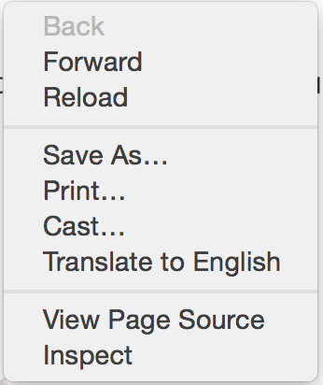
Try this:
Open up your browser and navigate to your favorite webpage.
Right-click (for Windows) or Control+Click (for Mac) then select “View Page Source.”
See what tags you can find.

Slide 13
HTML and Cascading Style Sheets (CSS): What’s the difference?
HTML is used for meaning and CSS is used for presentation.
HTML = fancy structured content
CSS = visual formatting of that content
Notes:
I’m going to talk about HTML first and then we’ll dive into CSS in more detail.

Slide 14

Let’s Get Started
To get started, go to http://codepen.com
Click on the button
You can sign up for an account or just select the “Anonymous user” option
Notes:
Most websites are a bunch of files stored in directories, just like the files on your own computer.

Slide 15
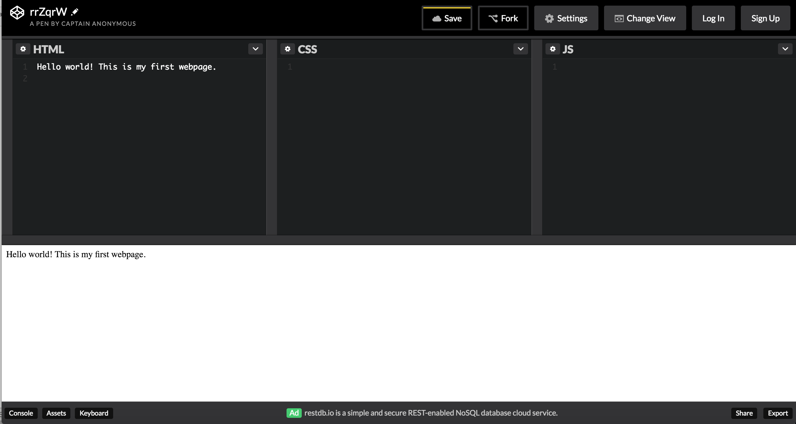
Try this:
In the “HTML” section, type “Hello World! This is my first webpage.” Click “Save” to save your work.
Notes:
Open a new text file and type the following text: Hello World! This is my first webpage.
Create a folder called “html” wherever you like to save files on your computer and save the file into the folder as myfirstpage.html
View the files online; your files don’t even have to be on the web for you to view them in a browser.
To view online, open a web browser such as Chrome, Firefox, Safari or Internet Explorer and in the address bar, where you usually type web addresses, type in the location of the file you just saved (for example, c:\html\myfirstpage.html) and hit return. Alternatively, go to the File menu of the browser, select Open, and browse for the file.

Slide 16
Tags
Surround content and apply meaning to it
Opening tags <html>
Closing tags </html>
Not all tags have closing tags
Line-break tag <br>
Image tag <img>
Remember: opening tag → content → closing tag
Notes:
You might come across “self-closing” tags, whereby a br tag, for example, will look like “<br />” instead of simply “<br>”. This is a remnant from XHTML, a form of HTML based on another markup language called XML. HTML5 is much more relaxed than XHTML and is fine with either format. Some developers prefer one way, some prefer the other. For the purposes of this class, I decided to stick with the simpler version, <br>.

Slide 17
Try this:
Return to your document and type the following:
<!DOCTYPE html>
<html>
<body>
This is my first web page.
</body>
</html>
Now save the document again, and see what it looks like.
Notes:
When you look at it online, the outward appearance of the page will not have changed at all, but the purpose of HTML is to apply meaning, not presentation, and this example has now defined some fundamental elements of a web page.
The first line on the top, <!DOCTYPE html>, is a document type declaration which lets the browser know which flavor of HTML you’re using (HTML5, in this case). It’s very important to stick this in - If you don’t, browsers will assume you don’t really know what you’re doing and act in a very strange way.
To get back to the point, <html> is the opening tag that kicks things off and tells the browser that everything between that and the </html> closing tag is an HTML document. The stuff between <body> and </body> is the main content of the document that will appear in the browser window.

Slide 18
Attributes
Tags can also have attributes
Attributes appear inside the opening tag
Values sit inside quotation marks
<tag attribute="value">Pudding</tag>
Note: Quotation marks aren’t always essential but it is a good-practice convention that is recommended for consistency and clarity.

Slide 19
Elements
Tags mark beginning and end of an element
HTML element usually consists of start tag + all the content inserted in-between + end tag:
<tagname>Content goes here...</tagname>
Examples:
<body>Whatever content is here</body> = body element
<title>James Bond</title> = title element

Slide 20
Nested Elements
HTML elements can be nested (elements can contain elements).
All HTML documents consist of nested HTML elements.
How many elements do you count on the page you just saved?
Notes:
The <html> element defines the whole document.
It has a start tag <html> and an end tag </html>.
The element content is another HTML element (the <body> element).
The <body> element defines the document body.
It has a start tag <body> and an end tag </body>.
The <p> element defines a paragraph.
It has a start tag <p> and an end tag </p>.
The element content is: This is my first web page.

Slide 21
Try this:
<!DOCTYPE html>
<html>
<head>
<title>My first web page</title>
</head>
<body>
This is my first web page.
How exciting!
</body>
</html>
Save and then view in the browser.
Notes:
Look at the document in your browser.
You might have expected your document to appear as you typed it, on two lines, but instead you should see something like this:
This is my first web page How exciting.
This is because web browsers don’t usually take any notice of what line your code is on. It also doesn’t take any notice of spaces (you would get the same result if you typed “This is my first web page How exciting”).
If you want text to appear on different lines or, rather, if you intend there to be two distinct blocks of text (because, remember, HTML is about meaning, not presentation), you need to explicitly state that. In HTML, one way you can organize blocks of text is by using the paragraph element.

Slide 22
Paragraphs
<p> is used for paragraphs.
HTML content is like a book.
You specify document structure.
Whatever you don’t put in won’t happen.
Notes:
Look at the results of this.
The two lines will now appear on two lines because the browser recognizes them as separate paragraphs.
Also, if you want text to appear on different lines or, rather, if you intend there to be two distinct blocks of text (because, remember, HTML is about meaning, not presentation), you need to explicitly state that.

Slide 23
Try this:
<!DOCTYPE html>
<html>
<head>
<title>My first web page</title>
</head>
<body>
<p>This is my first web page.</p>
<p>How exciting!</p>
</body>
</html>
Save and then view in the browser.
Notes:
Now let’s talk about some other HTML elements, including the paragraph element.

Slide 24
Emphasis
<em></em> = emphasize text in paragraph—like italic, but not exactly
<strong></strong> = indicate strong importance within paragraph–like boldface
Notes:
In addition to using HTML tags to structure lines of content, you can insert tags in the middle of sentences for emphasis.
Traditionally, browsers will display em in italics and strong in bold by default but they are not the same as <i></i> and <b></b> tags which (although they have been tenuously redefined in HTML5) have their origins in italic and bold.
Remember: HTML isn’t for presentation. If you want to emphasize something visually (making something italic, for example), you almost certainly want to give it general emphasis. You can’t speak in italics.

Slide 25
Try this:
<!DOCTYPE html>
<html>
<head>
<title>My first web page</title>
</head>
<body>
<p>This is my first web page.</p>
<p>How exciting!</p>
<p>Yes, that really <em>is</em> exciting.</p>
<p><strong>Warning:</strong>Level of excitement may cause head to explode.</p>
</body>
</html>
Save and then view in the browser.

Slide 26
Headings
HTML tags specifically designed for headings:
<h1>, <h2>, <h3>, <h4>, <h5>, <h6>
<h1></h1> is top heading (only 1 per page)
<h6></h6> is lowest heading
Notes:
The <p> or paragraph tag is just the start of text formatting.

Slide 27
Try this:
<!DOCTYPE html>
<html>
<head>
<body>
<h1>My first web page</h1>
<h2>About</h2>
<p>This is a simple page put together using HTML</p>
<h2>Purpose of this Page</h2>
<p>To learn HTML</p>
</body>
</html>
Save and then view in the browser.
Notes:
Note that the h1 tag is only used once, as the main heading of the page. h2 to h6, however, can be used as often as desired, but they should always be used in order, as they were intended.
For example, an h4 should be a sub-heading of an h3, which should be a sub-heading of an h2.

Slide 28
Lists
There are three types of lists: unordered lists, ordered lists, and description lists.
Unordered lists are used for non-sequential lists with list items usually preceded by bullets.
Ordered lists are used for sequential lists, which are normally represented by incremental numbers.
Description list is a list of terms, with a description of each term.
Notes:
Unordered lists and ordered lists work the same way, except that unordered lists are used for non-sequential lists with list items usually preceded by bullets.
Ordered lists are used for sequential lists, which are normally represented by incremental numbers.
The ul tag is used to define unordered lists and the ol tag is used to define ordered lists. Inside the lists, the li tag is used to define each list item.
A description list is a list of terms, with a description of each term.
The <dl> tag defines the description list, the <dt> tag defines the term (name), and the <dd> tag describes each term.
Description lists are beyond the scope of this introductory course.

Slide 29
List Tags
<ul></ul> tag is used to define unordered lists.
<ol></ol> tag is used to define ordered lists.
Inside both lists, the <li></li> tag is used to define each list item.
Notes:
Unordered lists and ordered lists work the same way, except that unordered lists are used for non-sequential lists with list items usually preceded by bullets.
Ordered lists are used for sequential lists, which are normally represented by incremental numbers.
The ul tag is used to define unordered lists and the ol tag is used to define ordered lists. Inside the lists, the li tag is used to define each list item.

Slide 30
Try this:
<!DOCTYPE html>
<html>
<head>
<body>
<h1>My first web page</h1>
<h2>About</h2>
<p>This is a simple page put together using HTML</p>
<h2>Purpose of this Page</h2>
<ul>
<li>To learn HTML</li>
<li>To show off</li>
<li>Because I can</li>
</ul>
</body>
</html>
Save and then view in the browser.
Notes:
Let’s add some lists to our document to see how that looks.
Let’s start with an unordered list. Type in the code, save your document, then view in the browser.

Slide 31
Try this:
<!DOCTYPE html>
<html>
<head>
<body>
<h1>My first web page</h1>
<h2>About</h2>
<p>This is a simple page put together using HTML</p>
<h2>Purpose of this Page</h2>
<ol>
<li>To learn HTML</li>
<li>To show off</li>
<li>Because I can</li>
</ol>
</body>
</html>
Save and then view in the browser.
Notes:
If you look at this in your browser, you will see a bulleted list.
Simply change the <ul> tags to <ol> and you will see that the list will become numbered.

Slide 32
Try this:
… (Note: Keep the code above this line in your document and just change the portion below)
<h2>Purpose of this Page</h2>
<ul>
<li>To learn HTML</li>
<li>To show off</li>
<ol>
<li>To my boss</li>
<li>To my friends and acquaintances</li>
<li>To my guinea pig</li>
</ol>
<li>Because I can</li>
</ul>
</body>
</html>
Save and then view in the browser.
Notes:
Lists can also be included in lists to form a structured hierarchy of items or “nested lists”. Type this code into your document, save, then view in the browser.
There you have it! A list within a list. And you could put another list within that. And another within that. And so on and so forth.
Now we have an ordered list nested inside an unordered list.

Slide 33
Links
Value of Internet = all linked together
hypertext = system of linked text
anchor tag (<a></a>) used to define a link
href = Hypertext REFerence (to add destination of the link)
Notes:
So far you’ve been making a stand-alone web page, which is all very well and good, but what makes the Internet so special is that it all links together.
The “H” and “T” in “HTML” stand for “hypertext”, which basically means a system of linked text.
An anchor tag (<a></a>) is used to define a link, but you also need to add something to the anchor tag — the destination of the link. Don’t forget to close your anchor tag </a> or the whole rest of your document will become part of the link destination!

Slide 34
Try this:
<!DOCTYPE html>
<html>
<head>
<title>My first web page</title>
</head>
<body>
<h1>My first web page</h1>
<h2>What this is</h2>
<p>A simple page put together using HTML</p>
<h2>Why this is</h2>
<p>To learn HTML</p>
<h2>Where to find this tutorial</h2>
<p><a href="http://dataacademy.commerce.gov/previous-courses.html">Previous Course Materials</a></p>
</body>
</html>
Notes:
The destination of the link is defined in the href attribute of the tag. The link can be absolute, such as “http://dataacademy.commerce.gov”, or it can be relative to the current page.
So if, for example, you had another file called “flyingmoss.html” in the same directory then the line of code would simply be <a href="flyingmoss.html">The miracle of moss in flight</a>or something like this.
A link does not have to link to another HTML file, it can link to any file anywhere on the web.
A link can also send a user to another part of the same page they are on. You can add an id attribute to just about any tag, for example <h2 id="moss">Moss</h2>, and then link to it by using something like this: <a href="#moss">Go to moss</a>. Selecting this link will scroll the page straight to the element with that ID.

Slide 35
More About Links
can be absolute OR
relative
do not have to link to another file in same directory
can send user to another part of the same page they are on
Type in the following:
<h2 id=”courses">Courses</h2>
Then link to it by using something like this:
<a href="#courses">Go to previous courses</a>.
Notes:
The destination of the link is defined in the href attribute of the tag. The link can be absolute, such as “http://dataacademy.commerce.gov”, or it can be relative to the current page.
So if, for example, you had another file called “brilliantstudentslist.html” in the same directory then the line of code would simply be <a href=”brilliantstudentslist.html">Our best and brightest students</a>or something like this.
A link does not have to link to another HTML file, it can link to any file anywhere on the web.
A link can also send a user to another part of the same page they are on. You can add an id attribute to just about any tag, for example <h2 id=”courses">Courses</h2>, and then link to it by using something like this: <a href="#courses">Go to previous courses</a>. Selecting this link will scroll the page straight to the element with that ID.

Slide 36

Images
Everything we’ve explored so far is very text-centric.
Web is not just about text; it’s about images, video, and audio too.

Slide 37
Image Tags
<img> tag is used to put an image in an HTML document
Looks like this:
<img src="http://ex-image.com" width="120" height="90" alt=”Example">
No closing tag
The src attribute tells browser where to find image
Like <a> tag, path can be absolute, but usually relative.
Notes:
NOTE: The width and height attributes are necessary because if they are excluded, the browser will tend to calculate the size as the image loads, instead of when the page loads, which means that the layout of the document may jump around while the page is loading.
The alt attribute is the alternative description. This is an accessibility consideration, providing meaningful information for users who are unable to see the image (if they are visually impaired, for example).
Note that, like the br tag, because the img element does not enclose any content, no closing tag is required.
For example, if you create your own image and save it as “sparkleimage.jpg” in a directory called “images” then the code would be <img src="images/sparkleimage.jpg”>

Slide 38
Try this:
Create an image tag for the following image in your codepen.io HTML document.
For example, the URL for this kitten image placeholder is: http://placekitten.com/200/300 so then the code would be:
<img src="http://placekitten.com/200/300”>
Extra credit: Create a link that takes you to another website that is centered on the image. Good luck!
Notes:
Notice that our <img> tag is “nested” within our href tag. That way, the link will be active on the image itself, so when you click on the image it takes you somewhere.
Solution: <p><a href="http://commerce.gov"><img src="http:/placekitten.com/200/300" width=”200" height=”300" alt=”Cute Kitten"></a></p>

Slide 39
Tables
HTML tables = best known for being used and abused to lay out pages.
Correct use of tables = to structure tabular data
Tables can contain all sorts of HTML elements: text, images, lists, other tables, etc.

Slide 40
Table Tags
<table> element defines the table.
<tr> element defines a table row.
<td> element defines a table data cell.
<th> element defines a table header cell.
<tr> element is a “wrapper” for table cells:
All <th> elements must be enclosed inside <tr> tags.
All <td> elements must be enclosed in <tr> tags.

Slide 41
Try this:
<!DOCTYPE html>
<html>
<table>
<tr>
<th>Column 1 heading</th>
<th>Column 2 heading</th>
<th>Column 3 heading</th>
</tr>
<tr>
<td>Row 2, cell 1</td>
<td>Row 2, cell 2</td>
<td>Row 2, cell 3</td>
</tr>
<tr>
<td>Row 3, cell 1</td>
<td>Row 3, cell 2</td>
<td>Row 3, cell 3</td>
</tr>
</table>
</html>
Notes:
Type in the following text. Then, make changes to personalize your table. Put categories of things you like or what favorite colors you have, etc.
Then view it online to see your changes take effect.

Slide 42
Try this:
The best way to fully understand all of this is to play around with the HTML file and see what happens when you change things.
Go to my code pen: http://codepen.io/dcwebmaven/pen/gwAkxz
Try to apply some of the styles we discussed in this section. Change things around and see what happens. Good luck!

Slide 43
Cascading Style Sheets (CSS)

Slide 44
CSS
CSS, or Cascading Style Sheets, is a way to style and present HTML
HTML is the meaning or content, style sheet is the presentation
Styles have a basic format of ‘property: value’
Most properties can be applied to most HTML tags
Notes:
Applying CSS - How to apply CSS to HTML.
Selectors, Properties, and Values - The bits that make up CSS.
Colors - How to use color.
Text - How to manipulate the size and shape of text.
Margins and Padding - How to space things out.
Borders - How to specify the style, width, and color of an element's border.
Putting It All Together

Slide 45
Applying CSS
Three ways to apply CSS to HTML: inline, internal, external.
Inline=Inline styles are put directly into HTML tags using style attribute. <p style="color: red">text</p>
Internal=Embedded/internal styles are used for whole page. [Inside <head> element, style tags surround all styles for page.]
External=External styles are used for the whole, multiple-page website. [Separate CSS file includes all styles for site.]
Notes:
Inline styles are easy to apply but, if you remember, the best-practice approach is that the HTML should be a stand-alone, presentation free document, and so in-line styles should be avoided wherever possible.
Although internal is better than inline presentation, it is still usually preferable to keep the HTML and the CSS files separate, and so we are left with the best option: external style sheets.

Slide 46
Internal Styles
Internal=Embedded or internal styles are used for the whole page
Put style tags inside the head element
Style tags surround all the styles for page
Notes:
Although internal is better than inline presentation, it is still usually preferable to keep the HTML and the CSS files separate, and so we are left with the best option: external style sheets.
This will make all of the paragraphs in the page red and all of the links blue.

Slide 47
Try this:
<!DOCTYPE html>
<html>
<head>
<title>CSS Example</title>
<style>
p {
color: red;
}
a {
color: blue;
}
</style>
</head>
<body>
<p>This is a paragraph</p>
<a href="http://commerce.gov">This is a link</a>
</body> </html>
Notes:
Play around with changing the colors listed for “p” (paragraph) and “a” (anchor tags), change them and see what happens.

Slide 48
Selectors, Properties, and Values
selector {
property: value;
}
<style>
p {
color: red;
}
a {
color: blue;
}
</style>
Notes:
HTML has tags
CSS has selectors
In this class, we will be concentrating on HTML selectors, which are simply the names of HTML tags and are used to change the style of a specific type of element.
Selectors=names given to styles in internal and external style sheets
Selector has “properties” inside curly brackets { } (color, font-weight, background-color)
Value is given to the property following a colon
Semi-colons are used to separate the properties.

Slide 49
Linking to External Style Sheets
File saved as “style.css” in same directory as HTML page
Can be linked to in HTML like this:
<!DOCTYPE html>
<html>
<head>
<title>CSS Example</title>
<link rel="stylesheet" type="text/css” href="style.css"> ...
Notes:
The rel attribute defines the relationship that the linked resource has to the document from which it's referenced. In most cases, this resource will simply be “ stylesheet “, which means, not surprisingly, “the referenced document is a stylesheet.”

Slide 50
Length and Percentages
px (such as font-size: 14px) = unit for pixels
em (such as font-size: 4em) = unit for calculated size of font
pt (such as font-size: 12pt) = unit for points, measurements in printed media
% (such as width: 80%) = unit for percentages
Other units include pc (picas), cm (centimeters), mm (millimeters) and in (inches)
Example: body {
font-size: 14px;
color: navy;
}
When value is zero, you do not need to specify a unit
To specify no border, it would be border: 0
Notes:
There are many property-specific units for values used in CSS, but there are also some general units that are used by a number of properties and it is worth becoming familiar with these before continuing.
So “4em”, for example, is four times the current font size.
Note: “px” in this case, doesn’t actually necessarily mean pixels all of the time. Modern browsers allow users to zoom in and out of a page so that, even if you specify font-size: 12px, or height: 200px, for example, although these will be the genuine specified size on a non-zoomed browser, they will still increase and decrease in size with the user’s preference.

Slide 51
Colors
Use predefined name, RGB value, or hex code
Name: aqua, black, blue, fuchsia, gray, green, red, yellow, etc.
RGB: (red/green/blue) values of combinations between 0 and 255
0 = lowest level (no red) ⎯ 255 = highest level (full red)
Example: rgb(255,0,0)
rgb(100%,0%,0%)
Hex code: starts with a hash character (#) + can be three or six digits in length.
Example: #ff0000
#f00
Notes:
Transparent is also a valid value.
With the possible exception of black and white, color names have limited use in a modern, well-designed web sites because they are so specific and limiting.
Hexadecimal (previously and more accurately known as “sexadecimal”) is a base-16 number system. We are generally used to the decimal number system (base-10, from 0 to 9), but hexadecimal has 16 digits, from 0 to f.
Basically, the three-digit version is a compressed version of the six-digit (#ff0000 becomes #f00, #cc9966 becomes #c96, etc.). The three-digit version is easier to decipher (the first digit, like the first value in RGB, is red, the second green and the third blue) but the six-digit version gives you more control over the exact color.
Colors can be applied by using color and background-color (note that this must be the American English “color” and not “colour”).
RGB: (red/green/blue) values of combinations between 0 and 255.
0 is lowest level (no red)
255 is the highest level (full red) These values can also be a percentage.
Example: rgb(255,0,0)
rgb(100%,0%,0%)
Hex code=The hex number starts with a hash character (#) and can be three or six digits in length.
Example: #ff0000
#f00

Slide 52
Try this:
Green text on a yellow background could look like this:
h1 {
color: green;
background-color: yellow;
}
You can apply color and background properties to most HTML elements:
body {
font-size: 14px;
color: navy;
}
h1 {
color: #ffc;
background-color: #009;
}
Experiment with color and background-color to find the right combination for your web page.
Notes:
Apply color and background properties to most HTML elements, including body, which would change the colors of the page and everything in it.
Save the CSS file and refresh your browser.

Slide 53
Text
Change size & shape of text on web page with these properties:
Font-family = font itself, such as Times New Roman, Arial, or Verdana
Font-size = actual size of font
Font-weight = thickness of font and whether it’s bold or not
Font-style = whether the text is italic or not
Text-decoration = if text has got a line running under, over, or through it
Text-transform = changes text case (capital, lowercase, uppercase, none)
Notes:
Font-weight = thickness of font and whether it’s bold or not (common values are bold or normal)
Font-style = whether the text is italic or not. It can be font-style: italic or font-style: normal.
Text-transform = changes case of text (capitalize, lowercase, uppercase, none).

Slide 54
Text, cont’d.
letter-spacing and word-spacing properties = spacing between letters or words
line-height property sets height of lines in element, without adjusting size of font (number, a length, a percentage, or normal)
text-align property will align text to left, right, center, or justify
text-indent property will indent the first line of a paragraph to a given length or percentage
Notes:
The letter-spacing and word-spacing properties are for spacing between letters or words. The value can be a length or normal.
The line-height property sets the height of the lines in an element, such as a paragraph, without adjusting the size of the font. It can be a number (which specifies a multiple of the font size, so “2” will be two times the font size, for example), a length, a percentage, or normal.
The text-align property will align the text inside an element to left, right, center, or justify.
The text-indent property will indent the first line of a paragraph, for example, to a given length or percentage. This is a style traditionally used in print, but rarely in digital media such as the web.

Slide 55
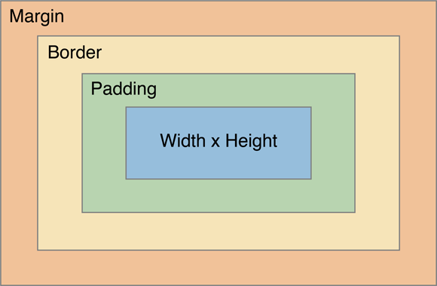
Margins, Padding, and Borders
Margin is space outside something
Padding is space inside something
Sides of an element can also be set individually:
margin-top, margin-right, margin-bottom, margin-left
padding-top, padding-right, padding-bottom, and padding-left
Borders can be applied to most HTML elements within the body
Notes:
Border-width sets the width of the border, most commonly using pixels as a value. There are also properties for border-top-width, border-right-width, border-bottom-width and border-left-width.
To make a border around an element, all you need is border-style. The values can be solid, dotted, dashed, double, groove, ridge, inset and outset.
Border-color sets the color.
Margins, padding and borders are all part of what’s known as the Box Model. The Box Model works like this: in the middle you have the content area (let’s say an image), surrounding that you have the padding, surrounding that you have the border and surrounding that you have the margin.
The Box Model can be applied to every element on the page, which gives great flexibility.

Slide 56
Try this:
The best way to fully understand all of this is to play around with the HTML and CSS files and see what happens when you change things.
Go to my code pen: http://codepen.io/dcwebmaven/pen/rrZqrW
Try to apply some of the styles we discussed in this section. Change things around and see what happens. Good luck!

Slide 57
Tools
Experiment: http://www.codepen.com
**Developer Tools in Chrome Browser: https://developers.google.com/web/tools/chrome-devtools/?hl=en
Developer Tools in Firefox:
https://developer.mozilla.org/en-US/docs/Tools/Tools_Toolbox
Developer Tools in Microsoft Edge:
https://developer.microsoft.com/en-us/microsoft-edge/platform/documentation/f12-devtools-guide/
**Recommended
Notes:
These are recommended tools and resources for further study.

Slide 58
Free Online Learning Resources
http://www.w3schools.com/
https://www.codecademy.com/
https://www.coursera.org/courses?languages=en&query=programming
https://www.edx.org/
https://www.khanacademy.org/
https://www.freecodecamp.com/
http://www.html5rocks.com/en/

Slide 59
Questions?
Notes:
Save the CSS file and refresh your browser.

